Slide 1
Air Pollution and the Burden of Childhood Asthma in the Contiguous United States using State-Specific Asthma incidence rates in 2010
Raed Alotaibi and Haneen Khreis

Slide 2
Practicum - Aim
Estimate the Burden of Disease of Asthma due to Traffic Related Air Pollution (TRAP) among Children in the US using State-Specific Incidence Rates and comparing the results with previous analysis using a single National Incidence Rate

Slide 3
Practicum Objectives
Objective 1: Prepare air pollution, census and asthma survey data sets for epidemiological analysis.
Objective 2: Estimate the burden of disease of childhood asthma due to air pollution in the US at a national and state level and compare health burden across the different social strata.
Objective 3: Design and develop health promotion material illustrating the impact of the burden of air pollution on children.
Objective 4: Demonstrate the underlying methods and explain the burden of disease project to the organizational workforce.
Objective 5: Participate in the write up of a scholarly article with the organization

Slide 4
Practicum deliverables
Objective 1:Prepare multiple burden data sets at varying geographical levels, tables for asthma incidence rates by state and a tutorial for step by step.
Objective 2:Produce tables and plots for the results of the study.
Objective 3:Publish interactive tables and maps.
Objective 4:Presentation and GITHUB repository
Objective 5:Write-up methods and results section of a paper.

Slide 5
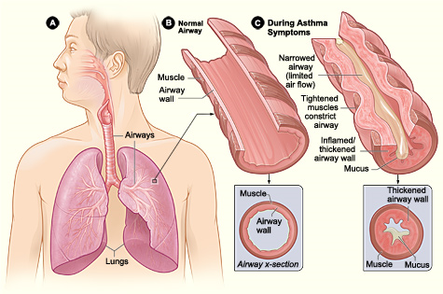
Introduction - Asthma
Asthma is the reversible or partially reversible obstruction of airflow presenting as episodes of wheezing, cough and shortness of breath with varying degrees of severity
By United States-National Institute of Health: National Heart, Lung, Blood Institute - http://www.nhlbi.nih.gov/health/health-topics/topics/asthma/, Public Domain, https://commons.wikimedia.org/w/index.php?curid=24760677

Slide 6
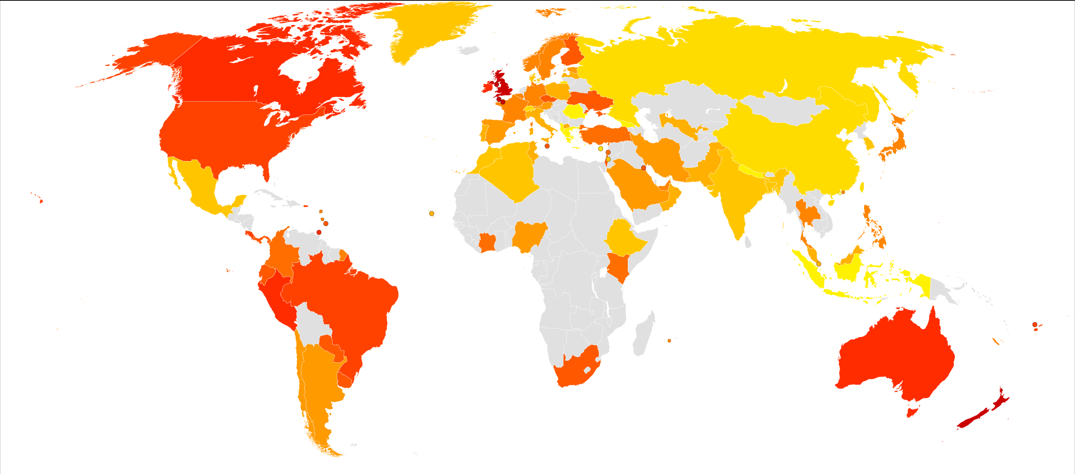
Introduction – Burden of Asthma
Globally
334+ million people with asthma
United States
20 million adults and 6 million children
2006-2010, around 60% if children with asthma → Persistent asthma
Image By Lokal_Profil - Vector map from BlankMap-World6, compact.svg by Canuckguy et al.Data from GINA - Global Burden of Asthma (2004-05)Created using the LP map generator., CC BY-SA 2.5, https://commons.wikimedia.org/w/index.php?curid=23760319
Notes:
Persistent asthma: Either being on long-term control medications or having uncontrolled asthma.
----
(Global Asthma Network, 2014)
(The Lancet, 2018)
(CDC, 2010)

Slide 7
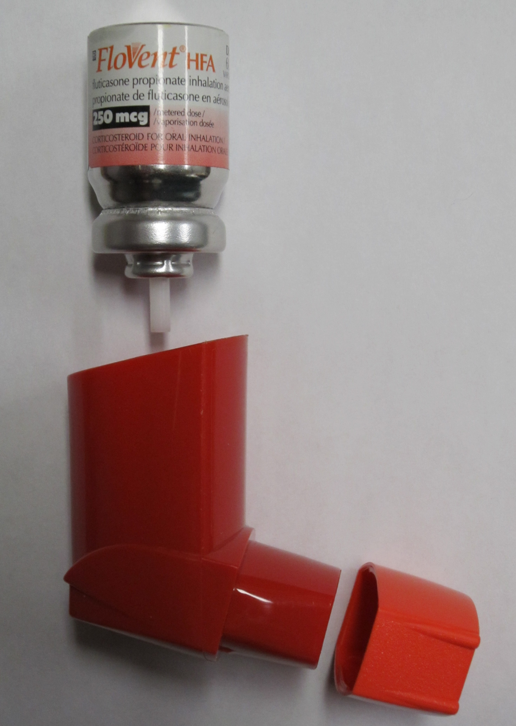
Introduction - Burden of Asthma
$56+ billion each year in health care costs in the US
Families with asthmatic children spend on average $1,737 more on health care
By James Heilman, MD - Own work, CC BY-SA 3.0, https://commons.wikimedia.org/w/index.php?curid=10313945
Notes:
Compared to families with children that are asthma free
-----
(CDC, 2010)
(Nurmagambetov et al. 2018)

Slide 8
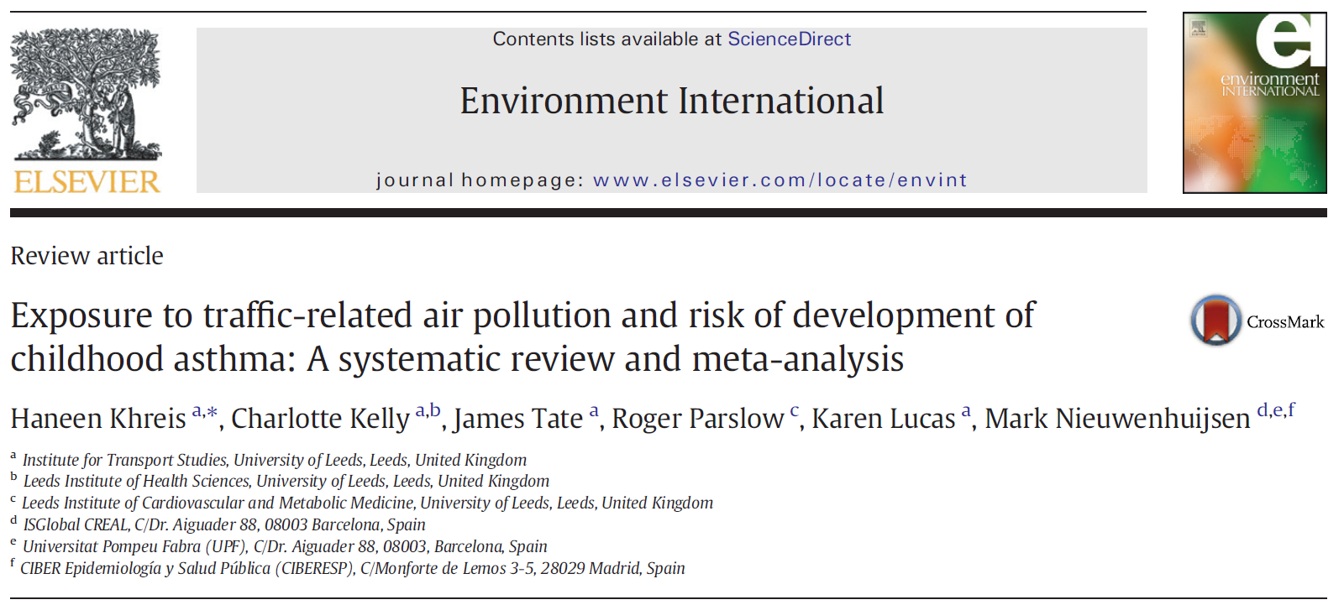
Introduction – TRAP and Asthma
Notes:
Asthma caused by Interaction of genetic and environmental factors
More recently TRAP has been identified to cause asthma among children
Systemic Review by Khreis et al 2017

Slide 9
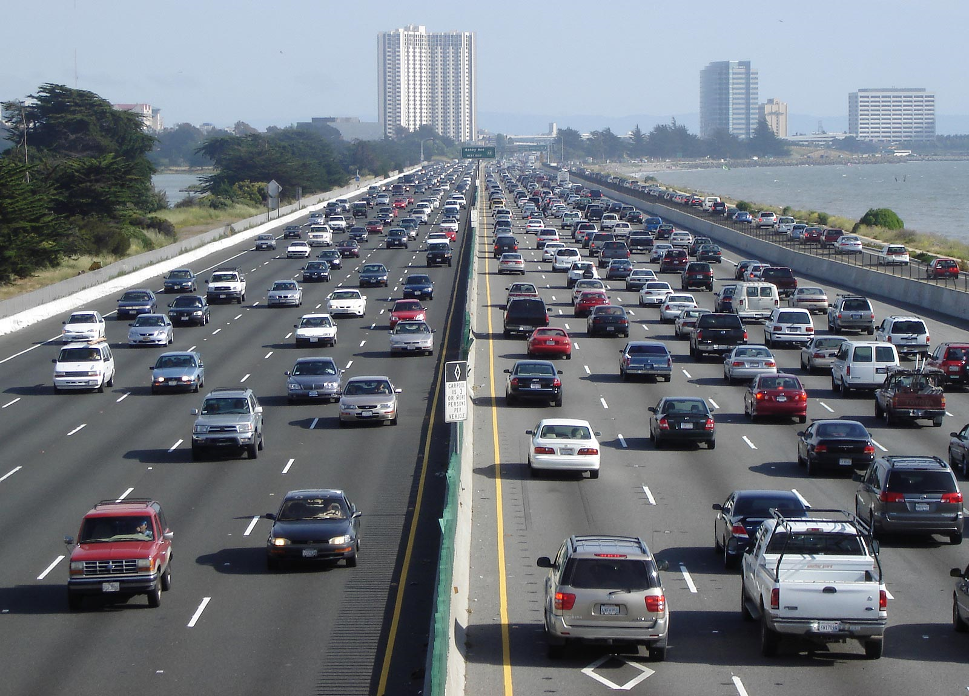
Introduction - TRAP
What is TRAP?
How is exposure to TRAP measured?
Estimated using surrogates
Buffer zone (distance to road and traffic volume)
Chemical surrogates (NO_{x}, PM, BC ..etc)
NO₂ is a good predictor of traffic
By User Minesweeper on en.wikipedia - Minesweeper, CC BY-SA 3.0, https://commons.wikimedia.org/w/index.php?curid=1302402
Notes:
(Ambient air pollution), although well known to exacerbate pre-existing asthma, did not lead to the onset asthma
Emerging evidence shows that more specific types of air pollution are associated with asthma onset, specifically traffic-related air pollution (TRAP), challenging prior belief
TRAP measured as Nitrogen Dioxide (NO₂), Black Carbon, Particulate Matter less than 2.5 um (PM_{2.5}) and Particulate Matter less than 10 um (PM₁₀)
------
(Krzyzanowski and Cohen, 2008)
(WHO, 2005)
(Anderson et al., 2011)
(Anderson et al., 2013)
(Khreis et al., 2017)

Slide 10
Methods - Overview
Estimated the Burden of Disease using the following data
Concentration Response Functions (Literature)
Air Pollution - NO₂ concentration (LUR* Models)
Asthma Incidence Rate (ACBS* and BRFSS*)
Census Data
Using standard burden of disease assessment methods to estimate
Attributable number of asthma incident cases due to NO₂ exposure
Percentage of all asthma incident cases
Among Children (<18 years)
*LUR = Land Use Regression
*Asthma Call Back Survey and Behavioral Risk Factor Surveillance System
Notes:
In other words, what is the percentage of new asthma cases due to TRAP

Slide 11
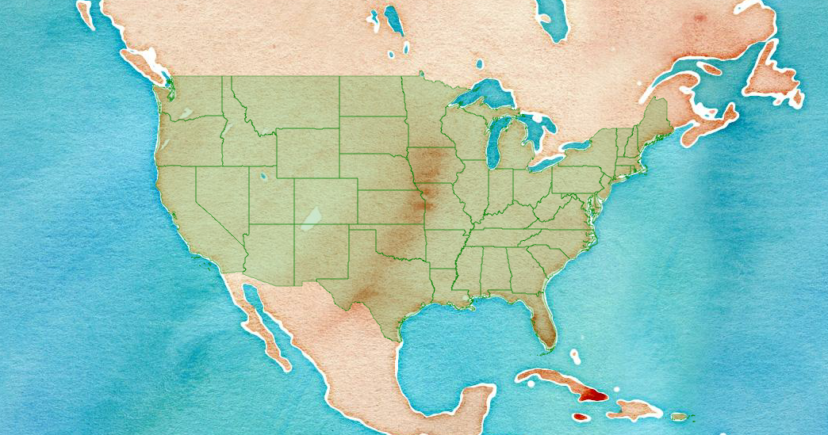
Methods – Location, Time point, and Geographical levels
Study Area and Time
48 states and D.C.
2010
Census Block level
Notes:
Contiguous US

Slide 12
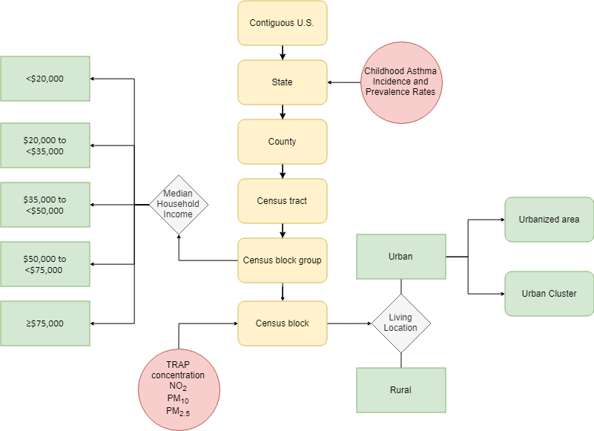
Notes:
Census blocks are the smallest available geographical unit for census data (Building block of all other units)
------
(US Census Bureau, 2010)

Slide 13
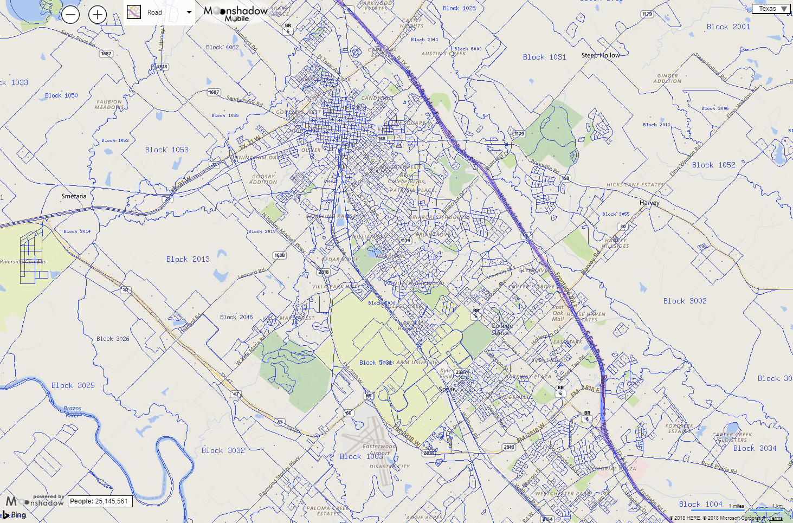
texas.us.censusviewer.com
Notes:
Map of census blocks in the Bryan-College Station area.
Each square represents a census block
Census blocks are usually delineated by a street, road, stream or any visible physical boundary
Blocks vary in size mainly depending on the population counts within them (Urban area vs rural area)

Slide 14

Methods – Census Data
Census data
National Historical Geographic Information System (NHGIS)
Population count (Census block)
Urban/Rural designation (Census block)
Median household income (block group)
Living Location
Urbanized Areas
Urban Clusters
Rural
Median Household Income
<$20,000
$20,000 to <$35,000
$35,000 to <$50,000
$50,000 to <$75,000
>=$75,000
Notes:
Source of the census data was the NHGIS website
For each census block we obtained Urban/Rural information and Median household income
---------
(Manson et al., 2017)

Slide 15
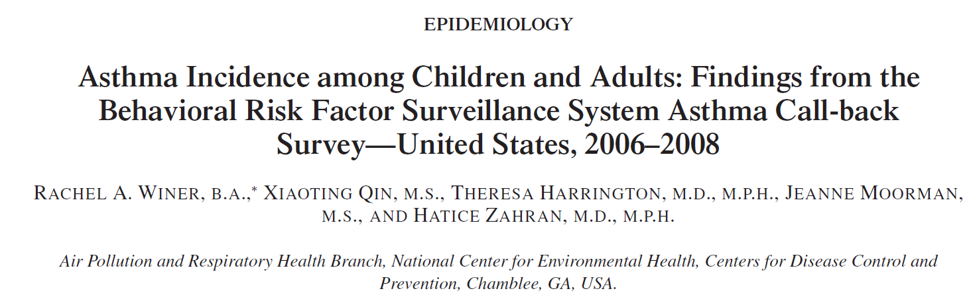
Methods – Asthma Incidence Rate
Asthma Call Back Survey
Period 2006-2010
Not all states had available data
Notes:
Asthma incidence rate was estimated as the number of newly diagnosed asthma cases, within a specified time period, among at-risk children.
The incidence study used data from the Behavioral Risk Factor Survey (BRFSS) and the Asthma Call Back Survey to estimate the incidence rate
Not all states were included in the surveys
-----------
(Winer et al. 2012)
(Blackwell et al., 2003)
(Bloom et al., 2011)

Slide 16
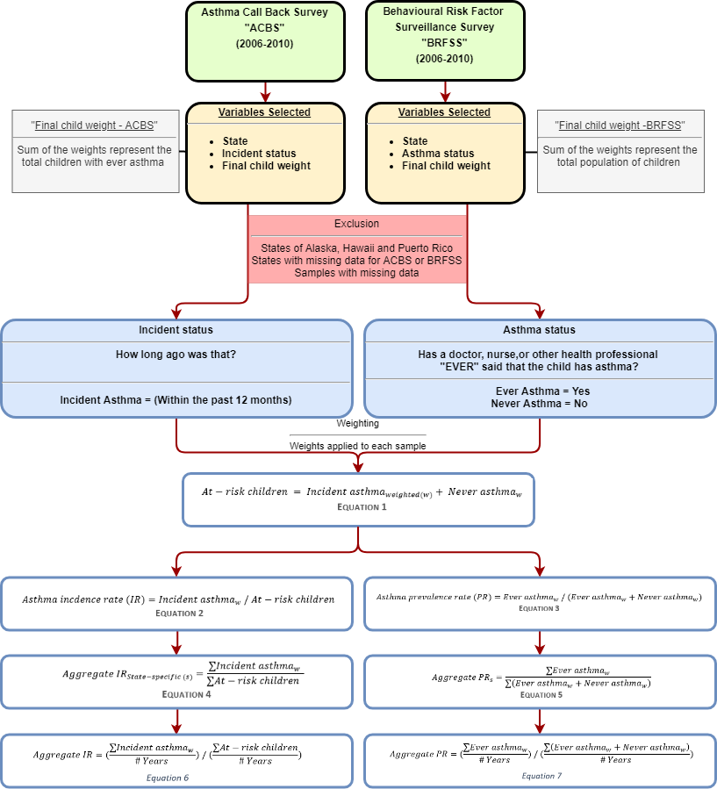
Methods – Asthma Incidence Rate

Slide 18
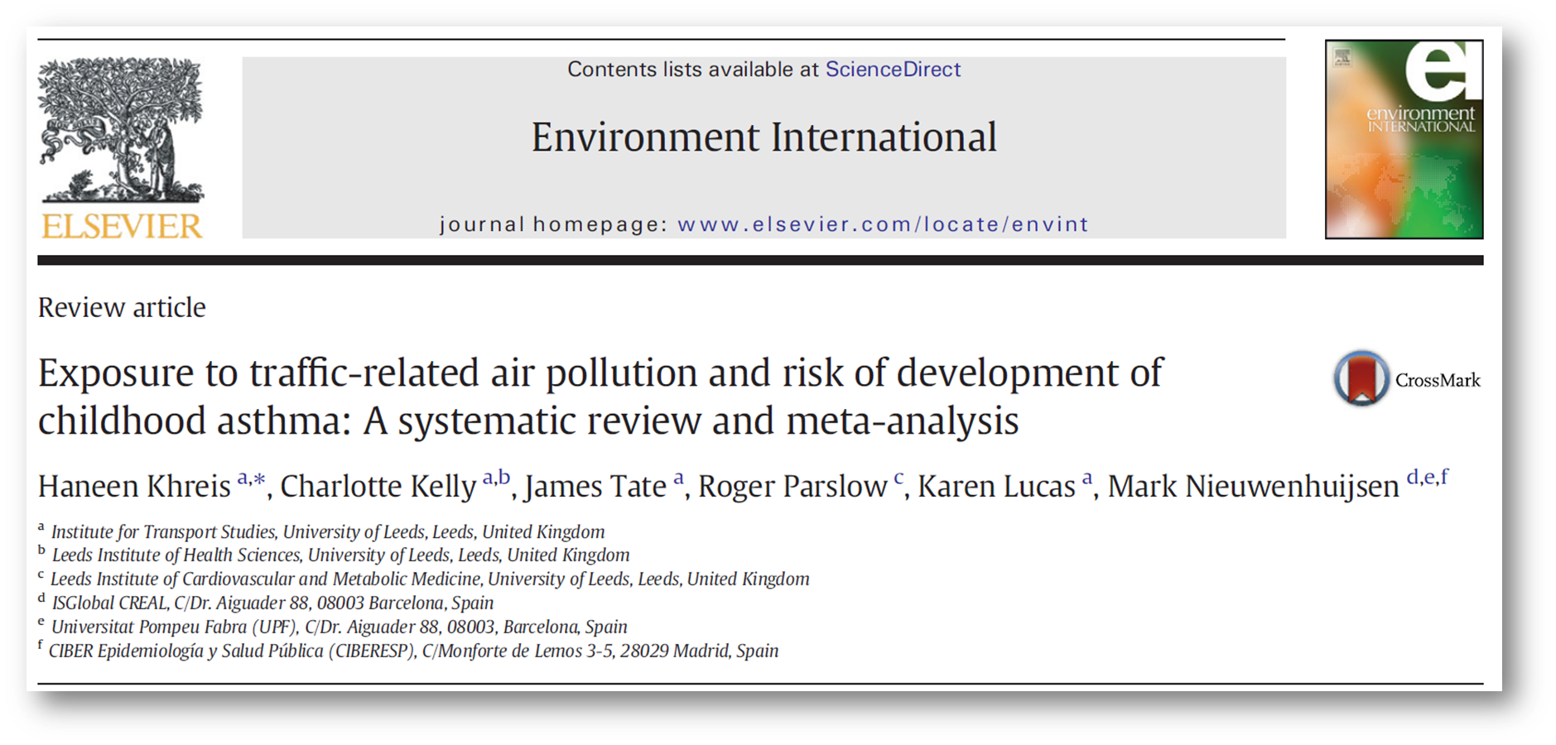
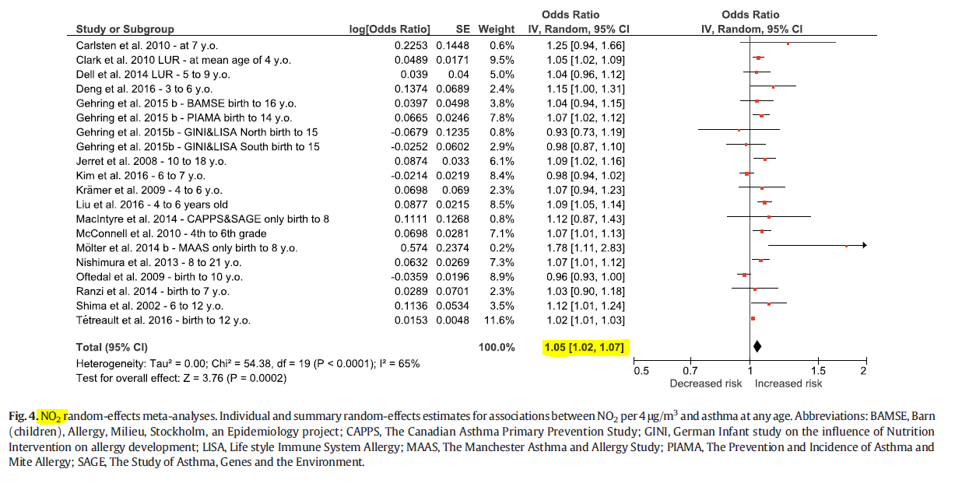
Methods – Concentration Response Functions
Notes:
OR 1.05 per 4 ug/m3

Slide 19
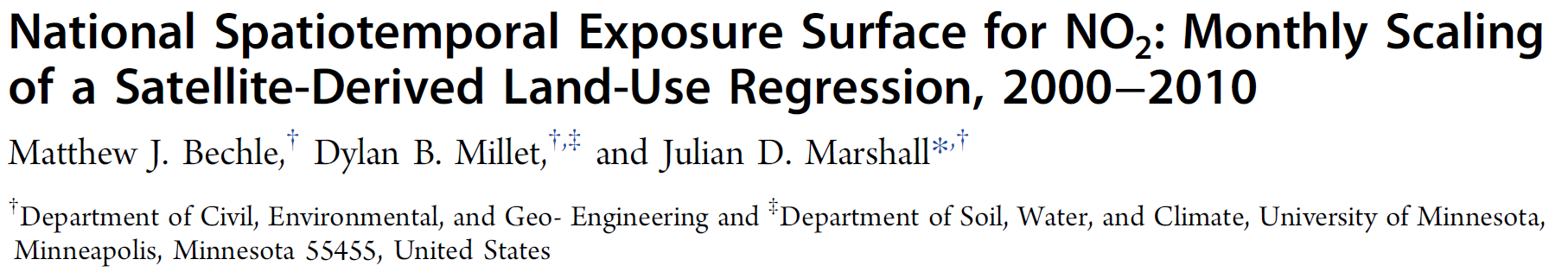
Methods – Exposure
Annual average concentration of NO₂ (ug/m³ )
Year 2010
Centroid of each census blocks

Slide 20
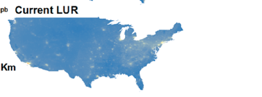
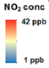
Methods – Exposure (NO₂)
Bechle et al. (2015) - Land Use Regression (LUR)
EPA air quality monitor readings
Satellite data
GIS (impervious surfaces, elevation, major roads, residential roads, and distance to coast)
Temporal scaling (average monthly, 2000-2011)
Highly predictive (R² = 0.82)
Notes:
(Bechle et al. 2015)

Slide 21

Methods - Software Used

Slide 22
Results

Slide 23
Methods – Census Data
5+ million populated census blocks
70+ million children
(80%) live in Urban areas
Geographic characteristics | Total populated census blocks | 6,182,882
 | Total census-designated urban areas | 3,590,278 (58%)
Demographic characteristics | Total population | 306,675,006
 | Total population of children (birth – 18) | 73,690,271 (24%)
 | Mean (range) number of children in census blocks | 12 (0-2214)
Population of children by living location | Rural | 13,763,183 (19%)
 | Urban clusters (≥2,500 and <50,000 people) | 6,994,464 (9%)
 | Urbanized area (≥50,000 people) | 52,932,624 (72%)
Population of children by median household income | <$20,000 | 2,614,804 (4%)
 | $20,000 to <$35,000 | 12,770,843 (17%)
 | $35,000 to <$50,000 | 18,573,954 (25%)
 | $50,000 to <$75,000 | 21,953,876 (30%)
 | ≥$75,000 | 17,763,239 (24%)
Notes:
Included census blocks :
5+ Blocks
72+ million children each year
~80% live in urban areas

Slide 24
 | 2006 | 2007 | 2008 | 2009 | 2010 | Total
BRFSS sample (weighted) | 55,094 (50,674,742) | 59,487 (43,661,381) | 61,862 (53,327,550) | 59,821 (47,747,373) | 57,200 (39,975,264) | 293,464
Ever asthma sample (weighted) | 7,168 (6,493,224) | 7,971 (5,763,409) | 8,255 (7,218,400) | 8,126 (6,279,938) | 7,483 (5,158,455) | 39,003
ACBS Sample (weighted) | 2,017 (4,580,870) | 2,797 (5,459,638) | 3,924 (4,343,245) | 4,095 (4,154,076) | 2,196 (3,116,669) | 16,156
Incident case sample (weighted) | 154 (404,276) | 173 (312,917) | 169 (385,818) | 153 (297,546) | 160 (319,743) | 809
At-risk sample (weighted) | 48,080 (30,825,589) | 51,689 (36,050,557) | 53,776 (26,491,259) | 51,848 (25,942,087) | 49,877 (22,900,850) | 255,270
Incidence rate | 13.1 | 8.7 | 14.6 | 11.5 | 14.0 | 11.6*
Prevalence rate | 12.8 | 13.2 | 13.5 | 13.2 | 12.9 | 13.1**
Number of states included | 18 | 26 | 20 | 17 | 17 | 32***

Slide 25
State | 2006* | 2007* | 2008* | 2009* | 2010* | Aggregate IR | Aggregate PR
Alabama |  |  |  |  |  | 11.6 | 14.4
Arizona | 23.7 | 6.8 |  |  |  | 15.2 | 13.1
Arkansas |  |  |  |  |  | 11.6 | 13.1
California | 12.1 | 6.5 |  |  |  | 9.3 | 12.2
Colorado |  |  |  |  |  | 11.6 | 13.1
Connecticut |  | 9.9 | 14.1 | 10.8 | 13.5 | 12 | 16
Delaware |  |  |  |  |  | 11.6 | 18.2
District of Columbia | 5.3 | 28.8 |  |  |  | 17.7 | 19.9
Florida |  |  |  |  |  | 11.6 | 13.1
Georgia | 6.4 | 5.8 | 9.1 | 16.6 | 6.9 | 9.1 | 15.1
Idaho |  |  |  |  |  | 11.6 | 9
Illinois |  | 4.2 |  | 9.2 |  | 6.7 | 12.4
Indiana | 25.4 | 9.3 | 13.4 | 9.9 | 17.6 | 15.2 | 12.8
Iowa | 5 | 4 | 9.9 |  |  | 6.3 | 8.4
Kansas | 7.8 | 9.9 | 9.9 | 8.3 | 9 | 9 | 11.6
Kentucky |  |  |  |  |  | 11.6 | 14
Louisiana |  |  |  | 5.8 |  | 5.8 | 13
Maine | 13 | 8.7 | 5.8 |  |  | 9.2 | 13.2
Maryland | 16.2 | 8.6 | 11 | 17.3 | 2.3 | 11.2 | 14.8
Massachusetts |  |  |  |  |  | 11.6 | 13.1
Michigan | 5.3 | 7.7 | 5.2 | 13.4 | 29.3 | 12 | 13.6
Minnesota |  |  |  |  |  | 11.6 | 9.5
Mississippi |  | 10.8 |  |  | 17.2 | 14 | 14.2
Missouri | 21.2 | 10.3 | 7.2 |  |  | 12.9 | 13.9
Montana | 2.8 | 2 |  | 3.7 | 8.5 | 4.3 | 9.7
Nebraska | 11.9 | 8.3 | 8.9 | 3.3 | 12.9 | 9.1 | 9.3
Nevada |  |  |  |  |  | 11.6 | 10.9
New Hampshire | 11.5 | 13.8 | 10.4 |  |  | 12 | 12.1
New Jersey |  |  | 6.3 | 12.5 | 10.5 | 9.8 | 14.3
New Mexico |  | 3.2 | 9.5 |  | 7.2 | 6.7 | 12
New York | 12.9 | 6.1 | 28.4 | 11.2 |  | 14.7 | 15.8
North Carolina |  |  |  |  |  | 11.6 | 13.1
North Dakota |  |  |  |  |  | 11.6 | 8.9
Ohio |  | 13.1 | 17 |  |  | 15.1 | 12.3
Oklahoma |  | 9.2 | 10.1 |  | 12.9 | 10.8 | 14
Oregon |  | 11.1 |  |  |  | 11.1 | 11.1
Pennsylvania |  | 21.8 |  |  | 4.3 | 13.2 | 13.9
Rhode Island |  |  | 15.3 | 13.2 |  | 14.3 | 16.1
South Carolina |  |  |  |  |  | 11.6 | 13.1
South Dakota |  |  |  |  |  | 11.6 | 13.1
Tennessee |  |  |  |  |  | 11.6 | 13.1
Texas | 14.4 |  | 18.2 | 12.5 | 21 | 16.6 | 13.1
Utah |  | 15.4 | 11.9 | 5.6 | 9.3 | 10.4 | 10.2
Vermont | 13.5 | 4.4 | 8.5 | 21.2 | 10.4 | 11.5 | 13.8
Virginia |  |  |  |  |  | 11.6 | 13.6
Washington |  |  |  | 7.9 | 5.6 | 6.8 | 10.8
West Virginia |  | 11.8 |  |  |  | 11.8 | 12.7
Wisconsin | 12.3 |  |  |  |  | 12.3 | 10.6
Wyoming |  |  |  |  |  | 11.6 | 9.5

Slide 26
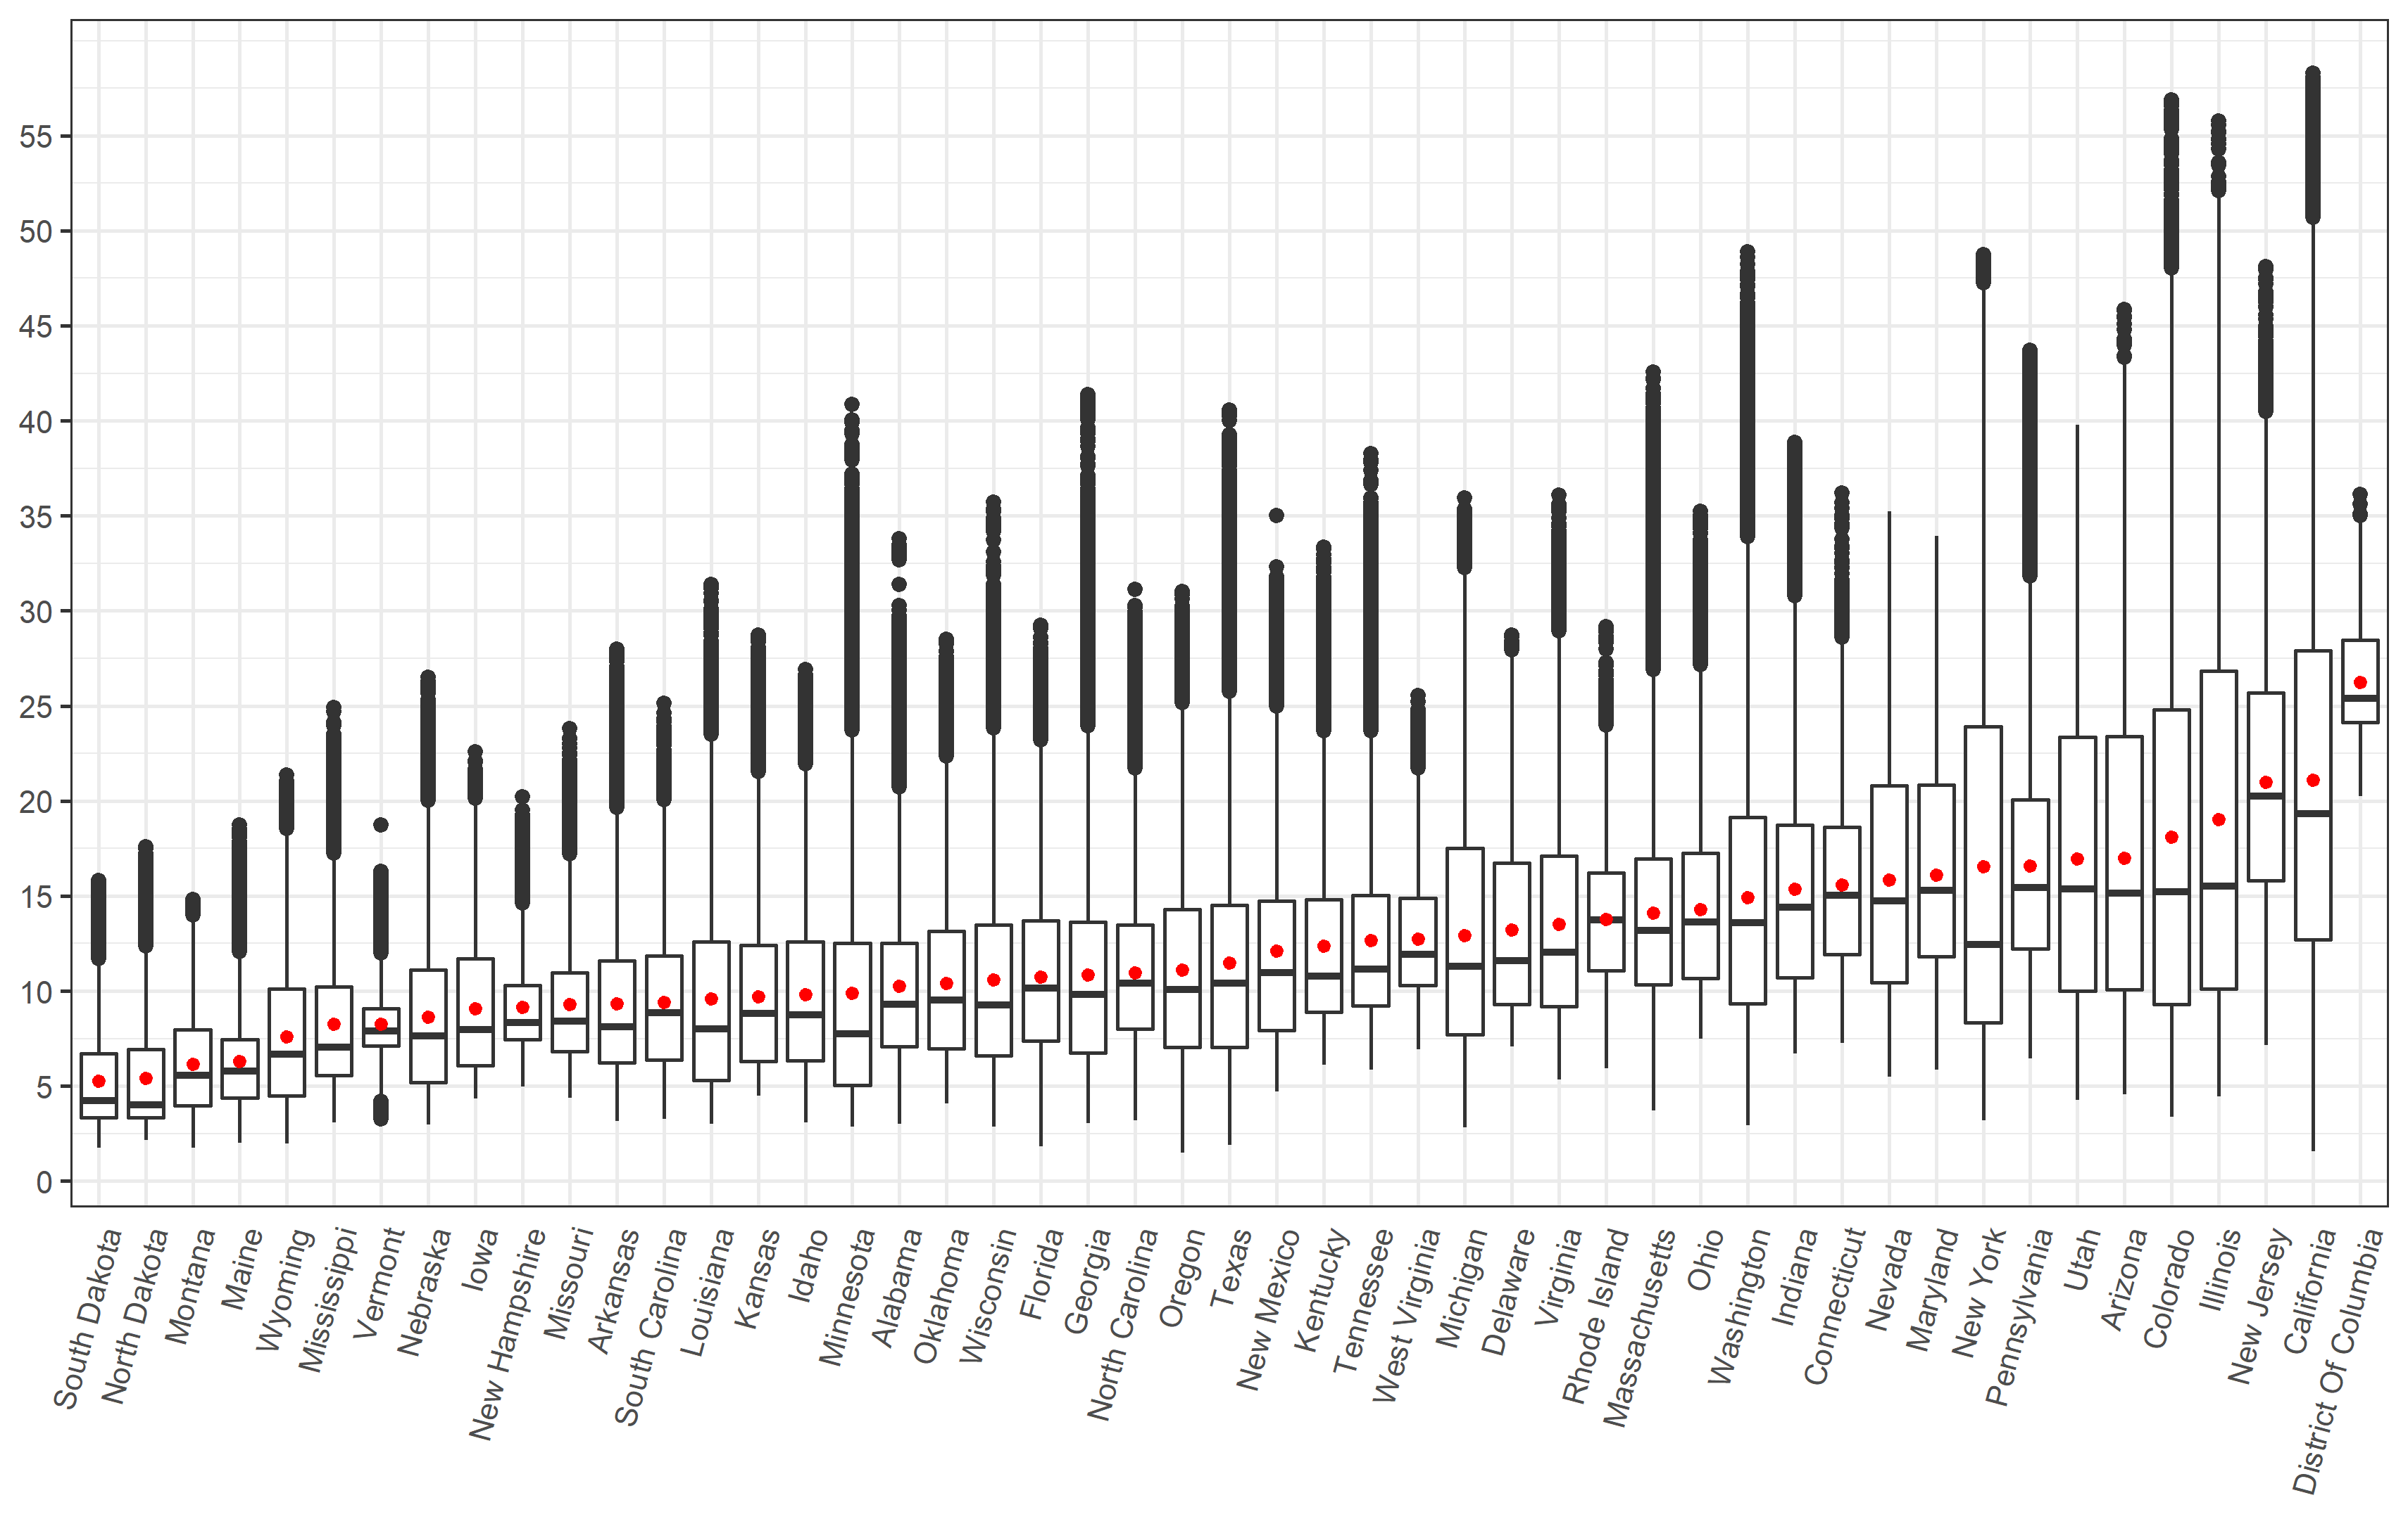
NO₂ concentration
 |  | Mean | Min | Max
Total |  | 13.2 | 1.5 | 58.3
By living location | Rural | 8.0 | 1.5 | 37.7
 | Urban cluster | 12.0 | 1.6 | 35.6
 | Urbanized area | 18.4 | 2.6 | 58.3
By median household income | <$20,000 | 16.1 | 2.0 | 56.8
 | $20,000 to <$35,000 | 13.2 | 1.6 | 58.3
 | $35,000 to <$50,000 | 11.8 | 1.5 | 58.0
 | $50,000 to <$75,000 | 12.8 | 1.6 | 55.7
 | ≥$75,000 | 16.5 | 2.1 | 55.5
NO₂ concentration:
13.2(1.5-58.3) ug/m³
Notes:
Overview of the mean values only
Thoroughly explain how to read the boxplot (go through it slowly and ask if this is clear)
The box plot has three pollutants (blue for NO2, yellow for PM10, and red for PM2.5) {point to bars when explaining}
For each pollutant we have two years (left bar is year 2000 and right bar is year 2010) {point to bars when explaining}
The X axis is the pollutant
The Y axis is the concentration of the pollutant (each point represents a census block)

Slide 27
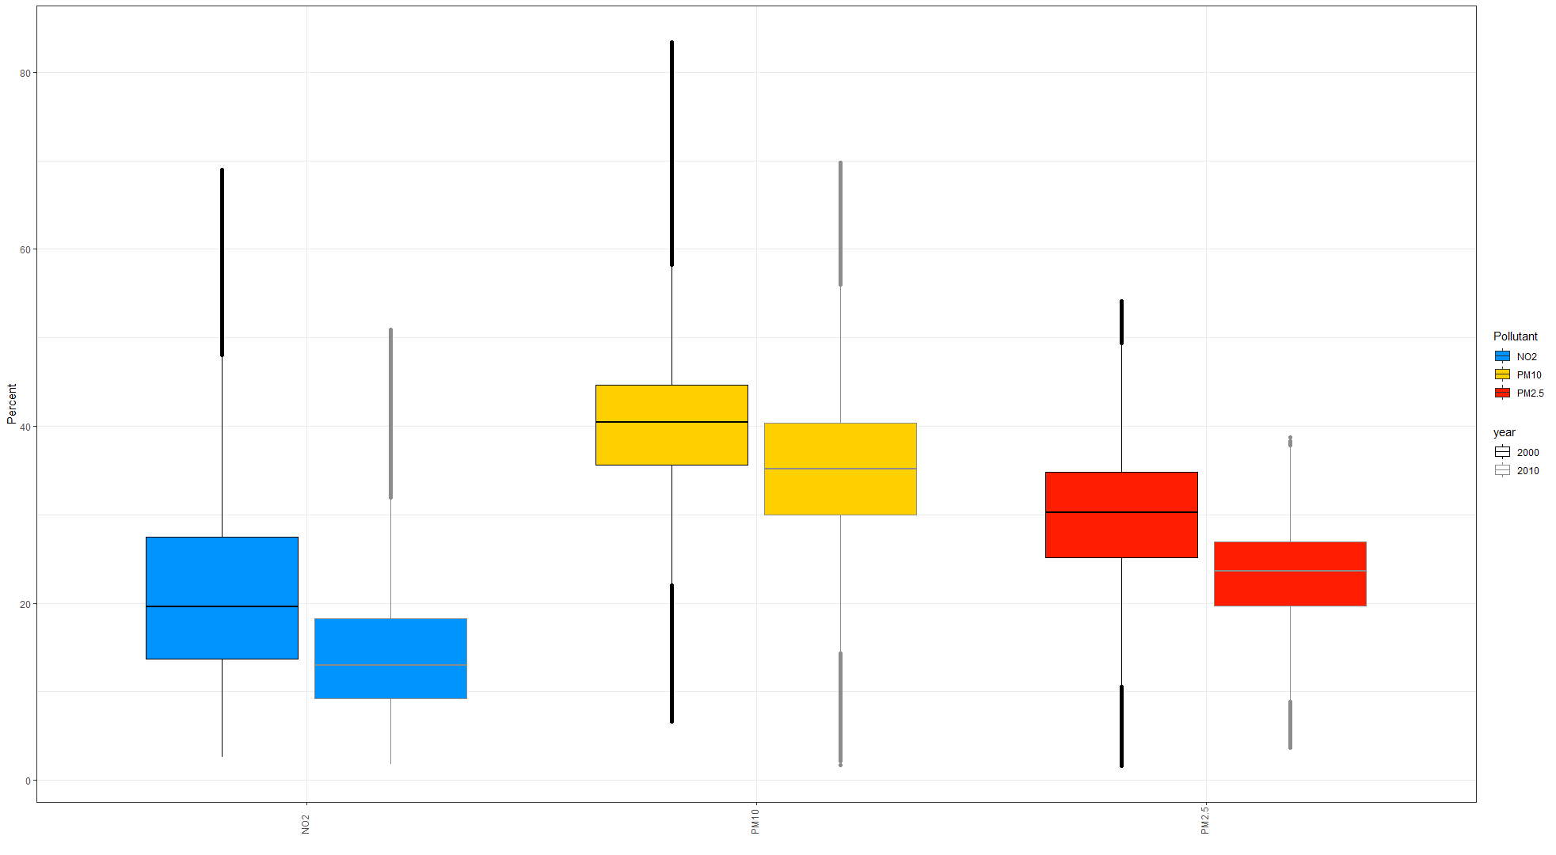
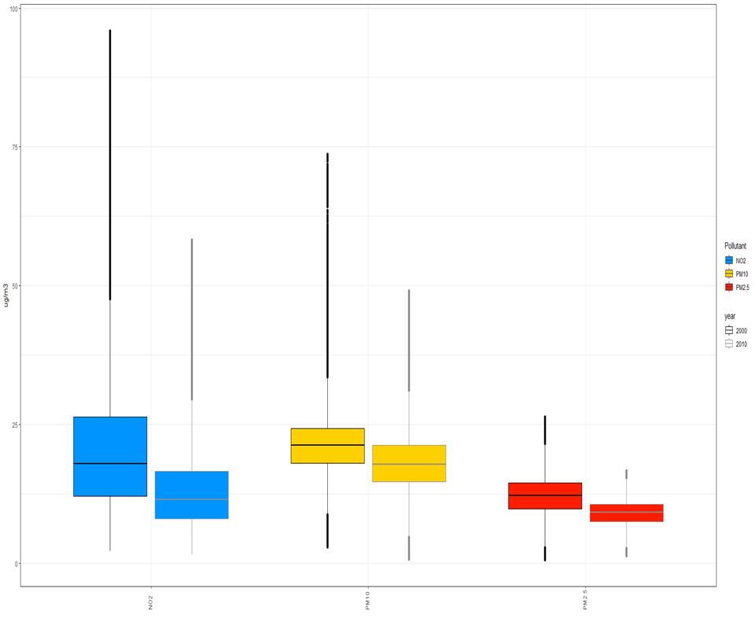
Childhood Asthma Incident Cases due to TRAP
Attributable number of cases and percentage of all cases
 | AC |  | % of all asthma cases |  | Change (%)
 | 2000 | 2010 | 2000 | 2010 | AC | % of all cases
NO₂ | 209,100 | 142,000 | 27% | 18% | -32% | -33%
PM_{2.5} | 247,100 | 190,200 | 31% | 24% | -23% | -24%
PM₁₀ | 331,200 | 286,500 | 42% | 36% | -13% | -14%
Number and Percentage of cases (NO₂)
209,100 → 142,000 (Attributable Cases)
27% → 18% (of all asthma cases)
Notes:
The X axis is the pollutant
The Y axis is the Percent of childhood asthma due to TRAP (Burden)
Each point represent a census block (for example the lowest recorded percentage – point to the lower end, and vice versa)

Slide 28
Attributable Fraction
 | Results using flat national-level IR |  |  | Results using state-specific IR |  |  | Difference (%)
 | Incident cases | AC | AF | Incident cases | AC | AF | Incident cases | AC | AF
Total | 794,934 | 141,931 | 17.9% | 747,437 | 131,739 | 17.6% | -6.0% | -7.2% | -1.7%
Rural | 148,470 (19%) | 14,466 (10%) | 9.7% | 140,799 (19%) | 13,788 (10%) | 9.8% | -5.2% | -4.7% | 1.0%
Urban cluster | 75,453 (9%) | 9,844 (7%) | 13.0% | 70,524 (9%) | 9,206 (7%) | 13.1% | -6.5% | -6.5% | 0.8%
Urbanized area | 571,011 (72%) | 117,621 (83%) | 20.6% | 536,113 (72%) | 108,745 (83%) | 20.3% | -6.1% | -7.5% | -1.5%
<$20,000 | 28,207 (4%) | 5,892 (4%) | 20.9% | 27,770 (4%) | 5,786 (4%) | 20.8% | -1.5% | -1.8% | -0.5%
$20,000 to <$35,000 | 137,765 (17%) | 25,794 (18%) | 18.7% | 132,843 (18%) | 24,699 (19%) | 18.6% | -3.6% | -4.2% | -0.5%
$35,000 to <$50,000 | 200,367 (25%) | 34,549 (24%) | 17.2% | 188,466 (25%) | 32,088 (24%) | 17.0% | -5.9% | -7.1% | -1.2%
$50,000 to <$75,000 | 236,827 (30%) | 40,540 (29%) | 17.1% | 221,334 (30%) | 37,253 (28%) | 16.8% | -6.5% | -8.1% | -1.8%
≥$75,000 | 191,621 (24%) | 35,128 (25%) | 18.3% | 176,880 (24%) | 31,885 (24%) | 18.0% | -7.7% | -9.2% | -1.6%

Slide 29
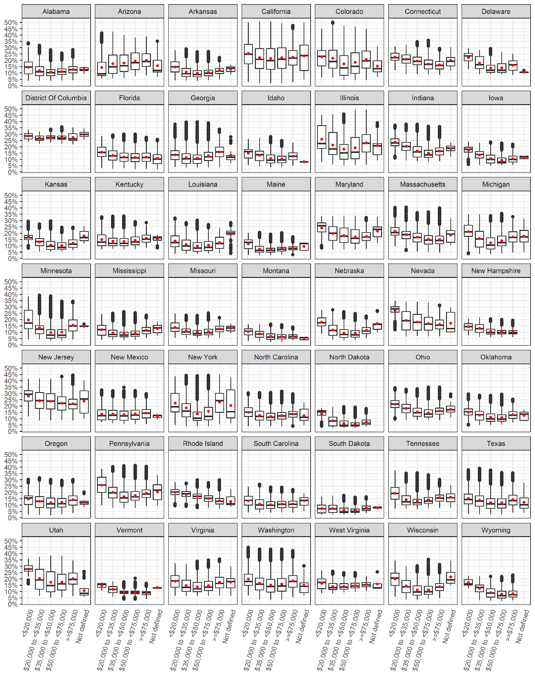

Slide 30
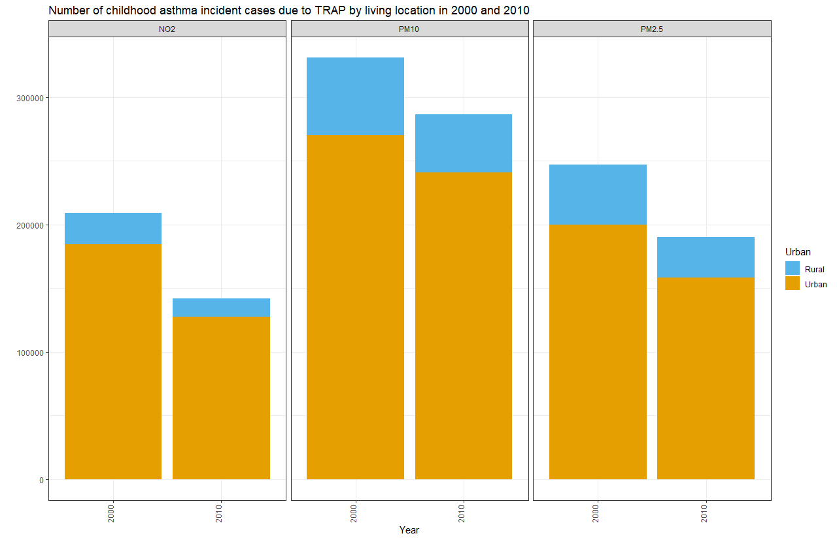
Urban vs Rural
Attributable number of cases and percentage of all cases
AC | AC |  | % of all asthma cases |  | Change (%)
 | 2000 | 2010 | 2000 | 2010 | AC
NO₂
Urban | 184,500 | 127,500 | 30% | 20% | -31%
Rural | 24,600 | 14,500 | 15% | 10% | -41%
PM_{2.5}
Urban | 200,100 | 158,200 | 32% | 24% | -21%
Rural | 47,000 | 32,000 | 28% | 22% | -32%
PM₁₀
Urban | 270,100 | 240,800 | 44% | 37% | -11%
Rural | 61,100 | 45,700 | 36% | 31% | -25%
Percentage of all asthma cases (NO₂)
30% vs 15% (Urban vs Rural - 2000)
20% vs 10% (Urban vs Rural - 2010)
Notes:
There is three boxes, each box represent a pollutant.
Explain bar chart (total is total number of cases due to TRAP for each year, the blue portion is the rural and the brown portion is urban)
The boxplot (2nd plot) is for year 2010 only
Explain boxplot – hear we compare Urban vs rural ( blue is rural, brown is Urban)

Slide 31
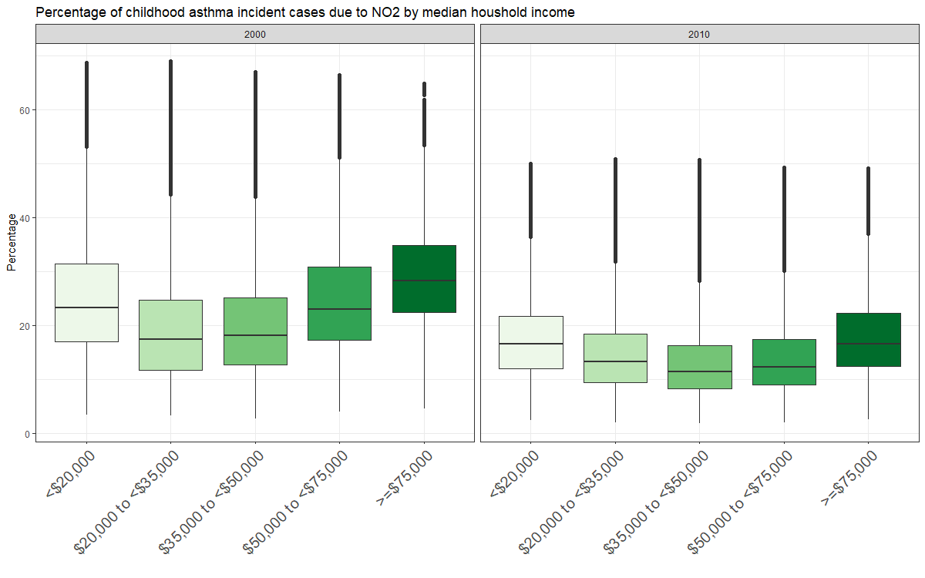
Median household income
Attributable number of cases and percentage of all cases
 |  | AC |  | % of all asthma cases
 |  | 2000 | 2010 | 2000 | 2010
NO₂
Median Household Income | < 20,000 | 13,700 | 5,900 | 31% | 21%
 | 20,000 to <35,000 | 59,600 | 25,800 | 26% | 19%
 | 35,000 to <50,000 | 60,700 | 34,600 | 25% | 17%
 | 50,000 to <75,000 | 50,900 | 40,500 | 27% | 17%
 | >= 75,000 | 24,100 | 35,100 | 29% | 18%
Percentage of cases in lowest income group (NO₂)
Lowest income group had highest burden
31% → 21% (of all asthma cases)
Notes:
The highest burden for both years was in the lowest income group

Slide 32
“Counterfactual” Scenarios
(1) WHO air quality guideline values
NO₂ → 40 µg/m³
300 preventable cases in 2010
<1% of all asthma cases
(2) Lowest modeled concentration
NO₂ → 1.48 µg/m³
127,700 preventable cases in 2010
16% of all asthma cases
Preventable number of asthma incident cases exceeding the “safe levels"
 | 2000 |  | 2010
 | AC | % of all asthma cases | AC | % of all asthma cases
WHO guidelines "safe level"
NO₂ | 11,100 | 1% | 300 | <1%
PM_{2.5} | 53,400 | 7% | 9,500 | 1%
PM₁₀ | 43,900 | 6% | 14,400 | 2%
Minimum concentration "safe level"
NO₂ | 188,300 | 24% | 127,700 | 16%
PM_{2.5} | 234,500 | 30% | 177,400 | 22%
PM₁₀ | 317,600 | 40% | 272,700 | 34%

Slide 33
2000 |  |  | 2010
City | Attributable Cases (NO₂₎ | Rank Change | City | Attributable Cases (NO₂₎
New York | 10,771 |  | New York | 6,756
Los Angeles | 5,710 |  | Los Angeles | 3,390
Chicago | 3,909 |  | Chicago | 2,506
Philadelphia | 1,826 |  | Phoenix | 1,278
Phoenix | 1,799 |  | Houston | 1,240
Houston | 1,606 |  | Philadelphia | 1,159
Detroit | 1,235 |  | San Diego | 821
San Diego | 1,205 |  | Dallas | 779
Dallas | 1,070 |  | San Jose | 622
San Jose | 934 |  | San Antonio | 592
Notes:
Philadelphia & Detroit dropped

Slide 34

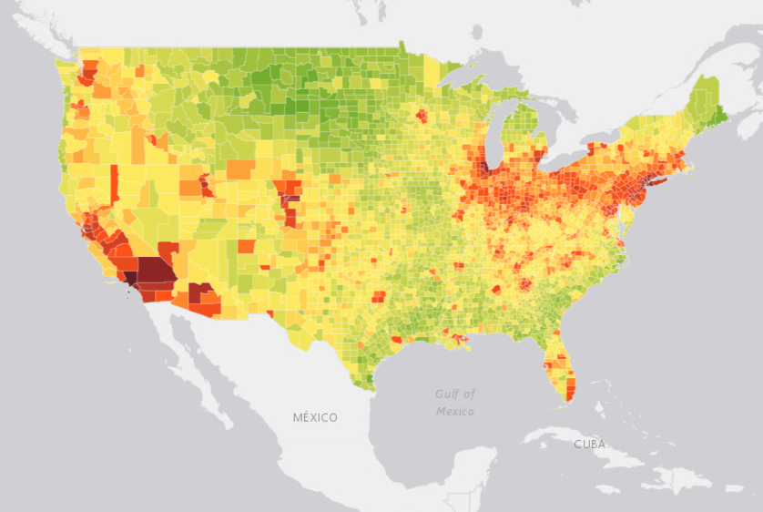
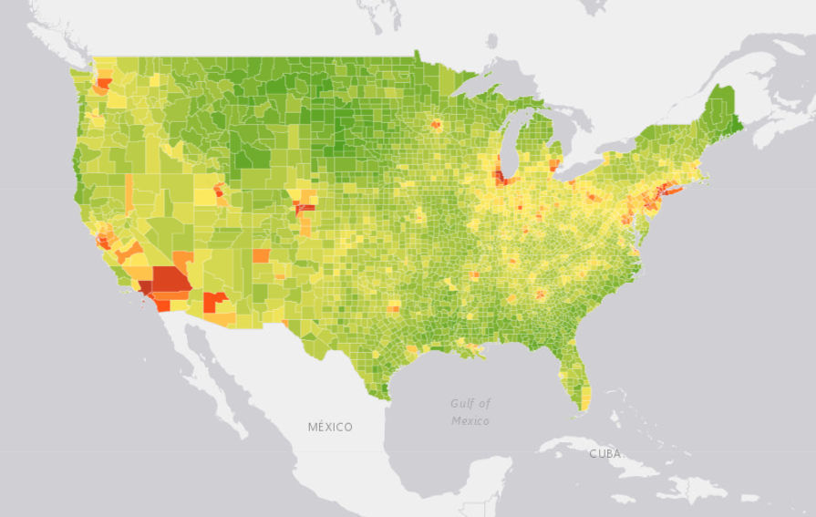
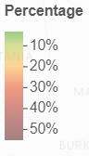
2000
2010
https://carteehdata.org/library/webapp/trap-asthma-usa
Notes:
Created Interactive maps at the county level
Access it through the CARTEEH DATAHUB

Slide 35
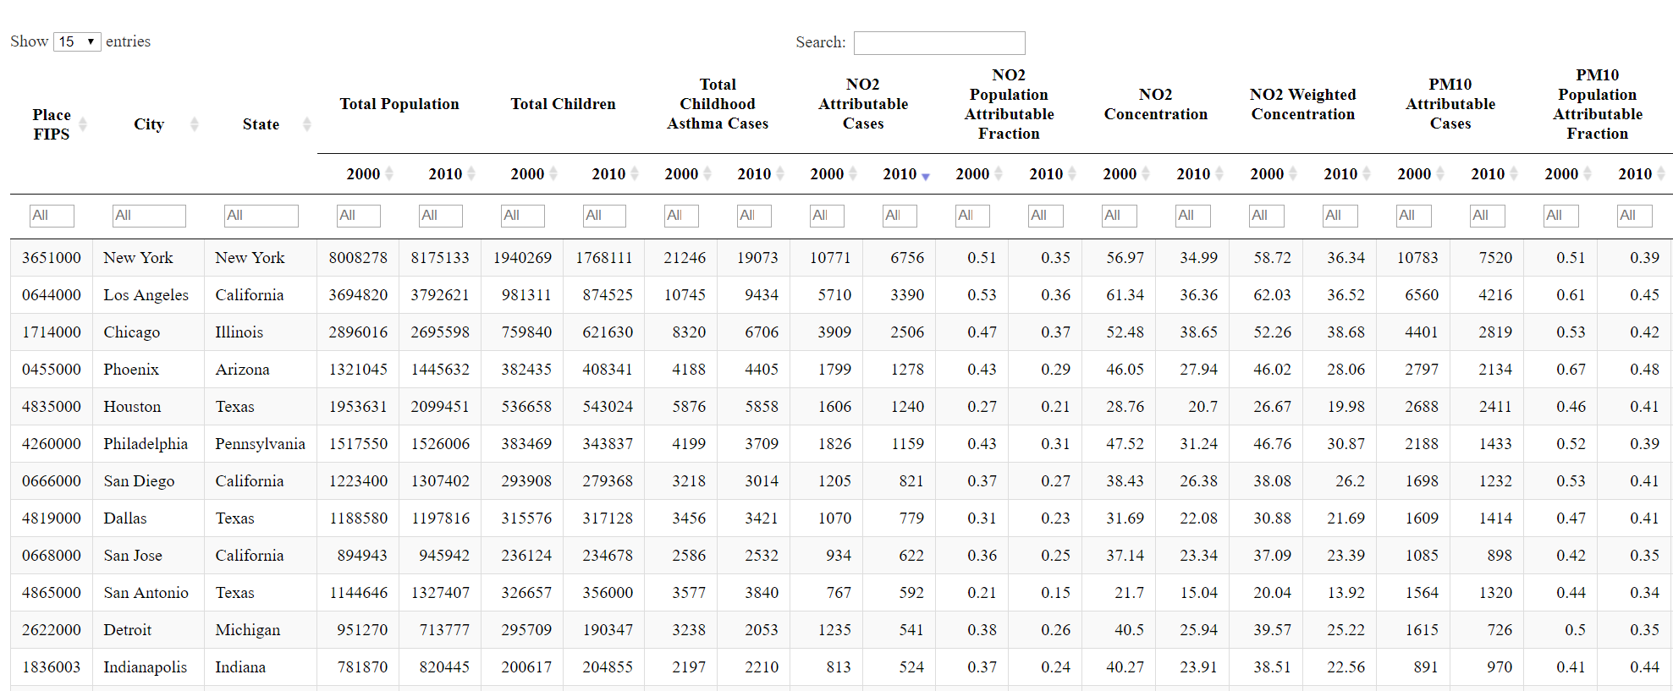
Notes:
Also produced look up table for 498 of the largest cities in the US

Slide 36
Discussion – Key Findings
Up to 142,000 of childhood asthma cases attributable to TRAP in 2010
18% of all asthma cases
Urban areas > Rural areas (Number and Percentage)
Lowest income groups had highest burden
2010 < 2000 burden, due air pollution levels
Notes:
First statement: TRAP is responsible for the development of a large portion of preventable childhood asthma in the US Give number and percentage
---------------
(Clark et al., 2017),

Slide 37
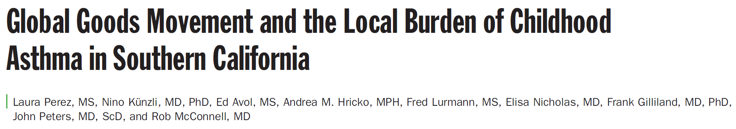
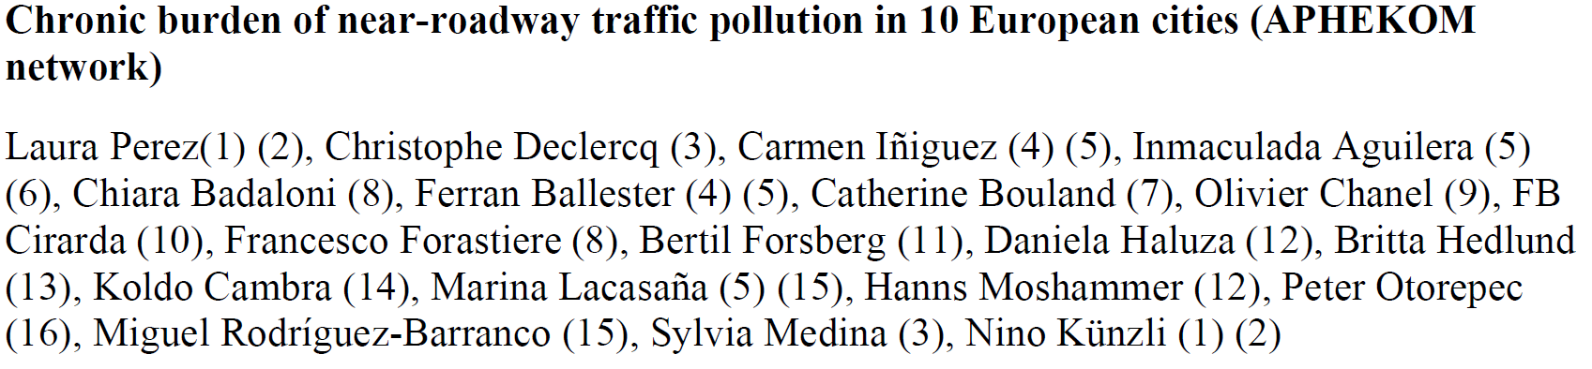
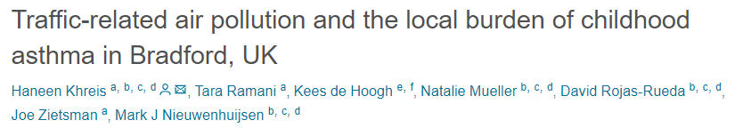
Discussion – Comparing with Previous Studies
Southern California and 10 European Cities study:
Lower than our estimates (18% to 42%)
Southern California → (6% to 9%)
European → (7% to 23%)
Used a proximity measure (75m buffer from road)
Southern California → 20% of children <75m
European → 31% of children <75m
Bradford study:
Comparable estimate (15% to 33%)
Used a LUR model
Notes:
Why are the two studies lower than our study
They used a buffer we used a LUR
Under exposure from the buffer (children >75m from road) – misclassification
A study by Ryan et al. (2007) ^{[18]} examining associations between infant wheezing and residing within 100 meter from stop-and-go bus and truck traffic showed that using a LUR model may reduce exposure misclassification that arises from a proximity model
----------------------
(Perez et al., 2013)
(Perez et al., 2009)
(Khreis et al. 2018)

Slide 38
Discussion - Strengths
CRF of pooled studies
Overcome statistical uncertainty
Address heterogeneity among different populations
CRF of continuous and pollutant specific exposure
Capture spatial variability of the different air pollutants.
Capture the spatial variability of exposure concentrations
LUR Model had high accuracy with fine spatial measurment

Slide 39
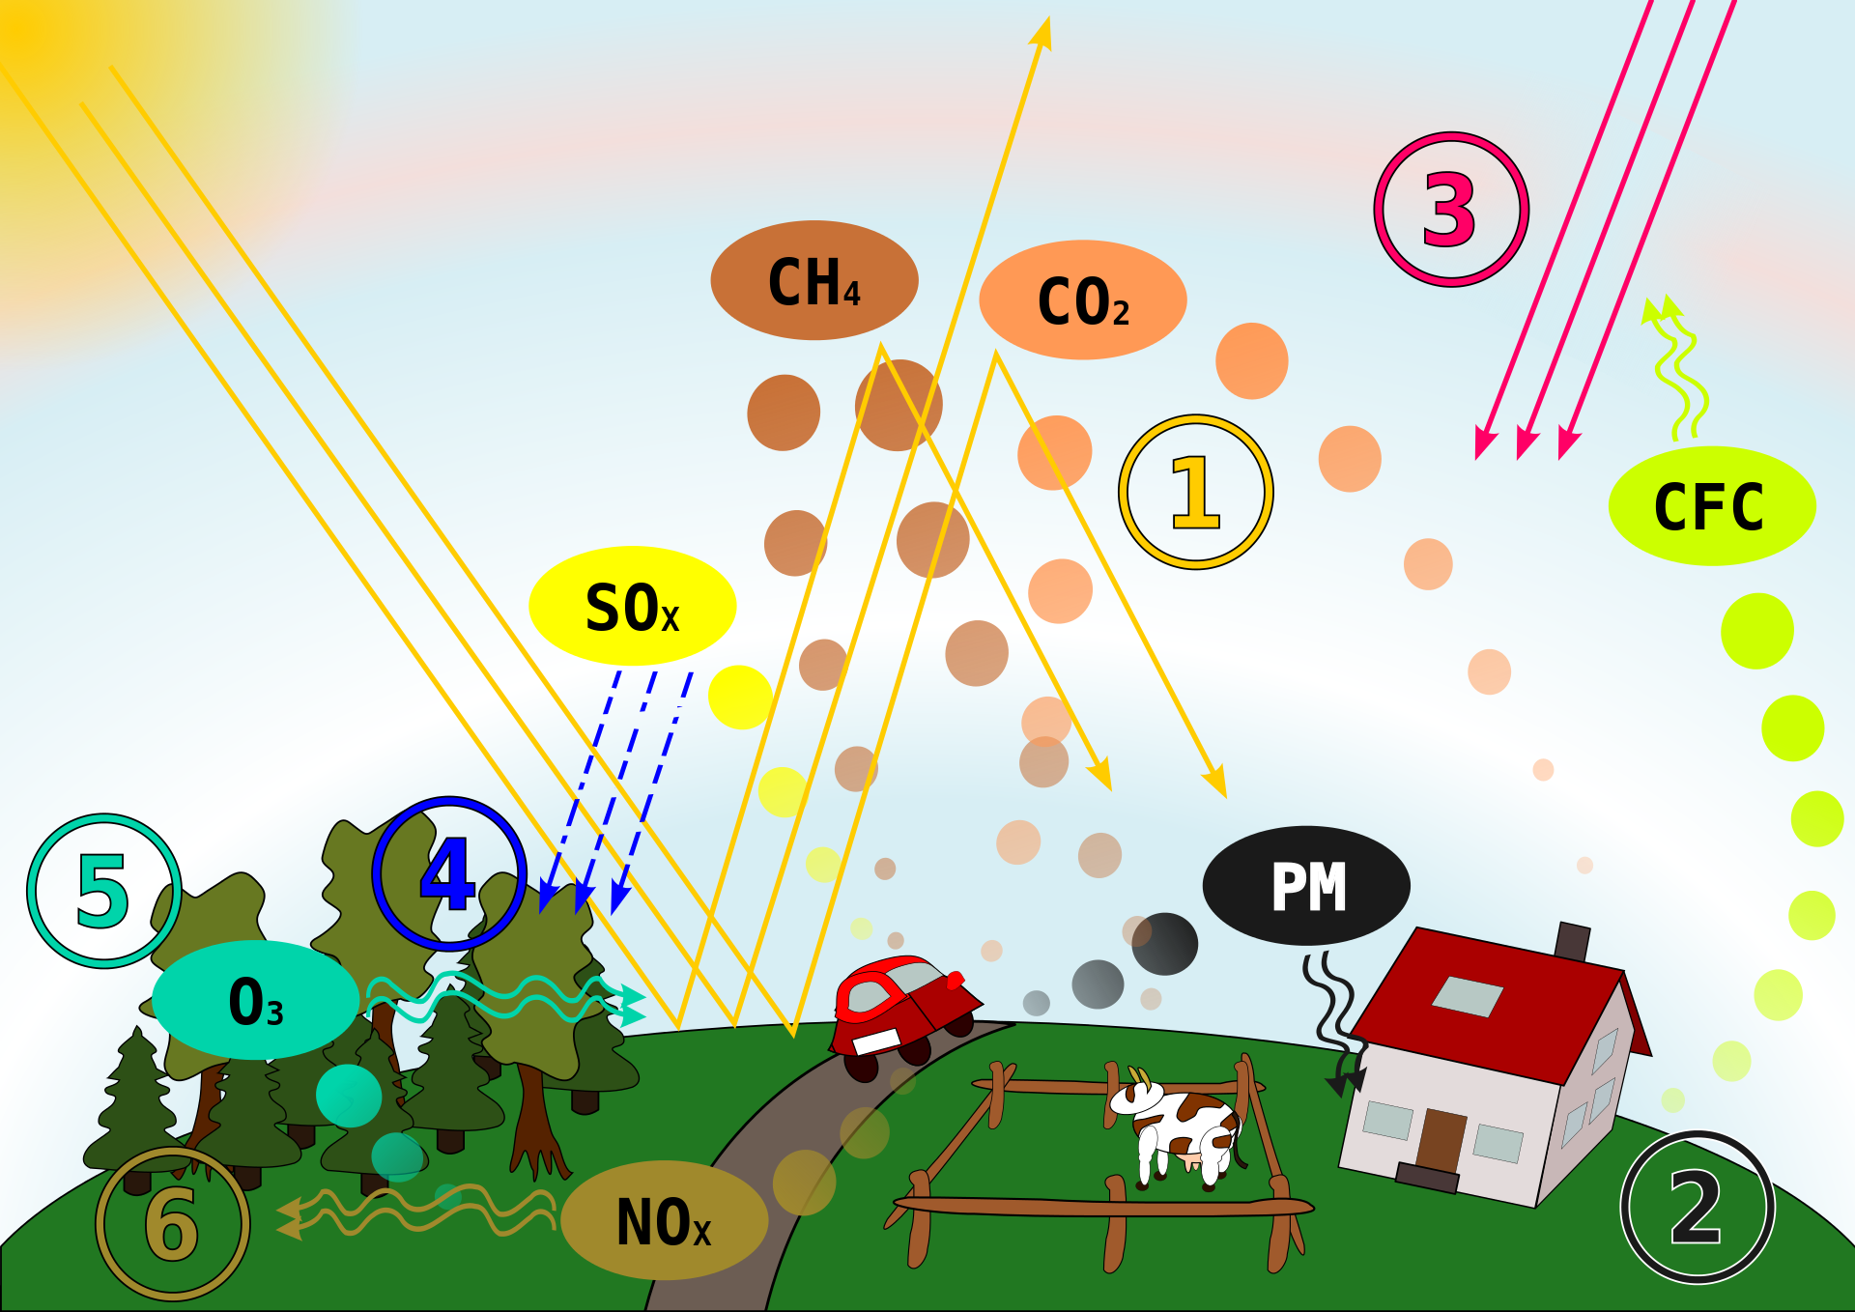
Discussion - Limitations
CRF of TRAP
Competing causes
Asthma Incidence Rate
Single asthma incidence rate
Simple model → Availability of data would increase accuracy
LUR model
Does not separate traffic from non-traffic sources
NO₂ is a good predictor of traffic
Urban/Rural
Urban estimates are more accurate
By chris 論 - This file was derived from: Luftverschmutzung-Ursachen&Auswirkungen.svg, CC BY 3.0, https://commons.wikimedia.org/w/index.php?curid=12276663
Notes:
Asthma incidence rate
-Limitation of available data made the model a simple model
CRF
-In other words, would reducing TRAP reduce all the estimated cases? We are not sure.
(Rowangould 2013)

Slide 40
Thank you

Slide 41
Extra Slides

Slide 42
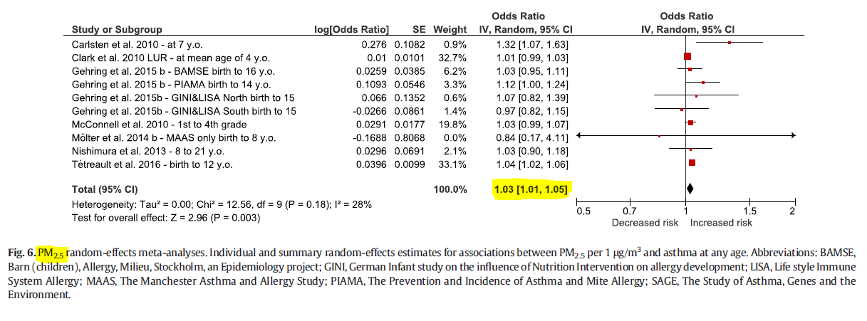
Introduction – New Evidence
Notes:
For PM2.5 = 10 papers

Slide 43
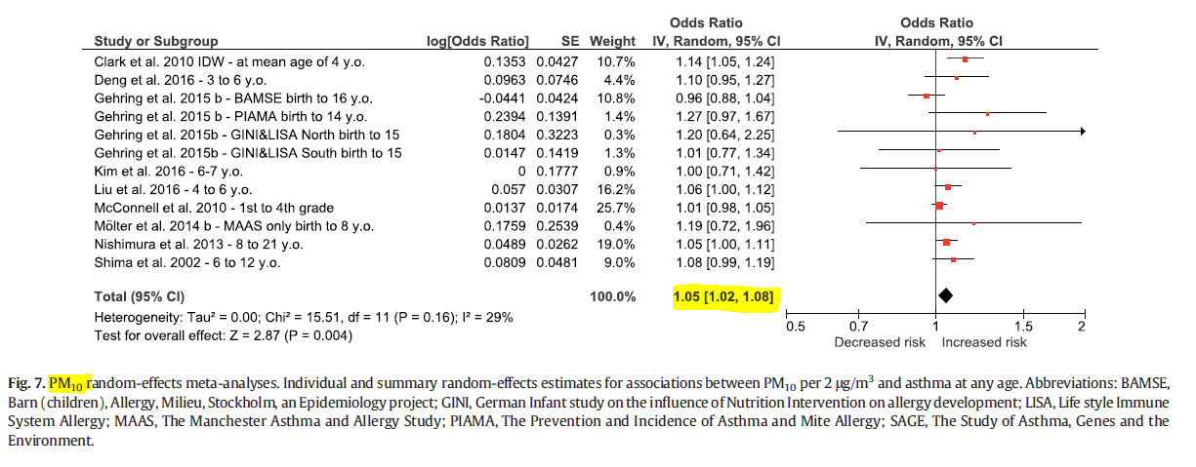
Introduction – New Evidence
Notes:
For PM10 = 12

Slide 44
Introduction - Rational
Few studies examined the burden of asthma attributable to TRAP
10 European cities – proximity to roadways accounted for 14% of childhood asthma
Southern California – proximity to roadways and ship emissions accounted for 9% of childhood asthma
No study examined the burden for the whole United States (US)
Notes:
Given the relatively new evidence, we found few studies examining the burden of asthma due to TRAP
Southern California study: Used an 8 year average concentration of NO₂ and O₃
₋₋₋₋₋₋₋
(Perez et al., 2013)
(Perez et al., 2009)

Slide 45
Methods - Formulas
Notes:
Combining children population counts, asthma incidence rate, pollutant-specific CRF and pollutant concentrations, we estimated
The total number of new incident asthma cases due to exposure to each pollutant and in each year, separately.
The estimates were done at each census block then summed up

Slide 46
Census data description
 | 2000 | 2010 | Change (%)
Geographic characteristics
Total number of census blocks | 8,164,718 | 11,007,989 | 35%
Total census blocks included | 5,280,214 (65%) | 6,182,882 (56%) | 17%
Total census blocks within urban areas | 2,970,347 (36%) | 3,590,278 (33%) | 21%
Demographic characteristics
Total population | 279,583,437 | 306,675,006 | 10%
Total population of children (birth - 18) | 71,807,328 (26%) | 73,690,271 (24%) | 3%
Mean (range) number of children in census blocks | 14 (0-4,713) | 12 (0-2,214) | -12%
Population of children by living location
Urban | 56,504,832 (79%) | 59,927,088 (81%) | 6%
Rural | 15,302,496 (21%) | 13,763,183 (19%) | -10%
Population of children by median household income
< 20,000 | 4,055,407 (6%) | 2,614,804 (4%) | -36%
20,000 to <35,000 | 20,694,588 (29%) | 12,770,843 (17%) | -38%
35,000 to <50,000 | 21,974,042 (31%) | 18,573,954 (25%) | -15%
50,000 to <75,000 | 17,350,990 (24%) | 21,953,876 (30%) | 27%
>= 75,000 | 7,732,301 (11%) | 17,763,239 (24%) | 130%

Slide 47
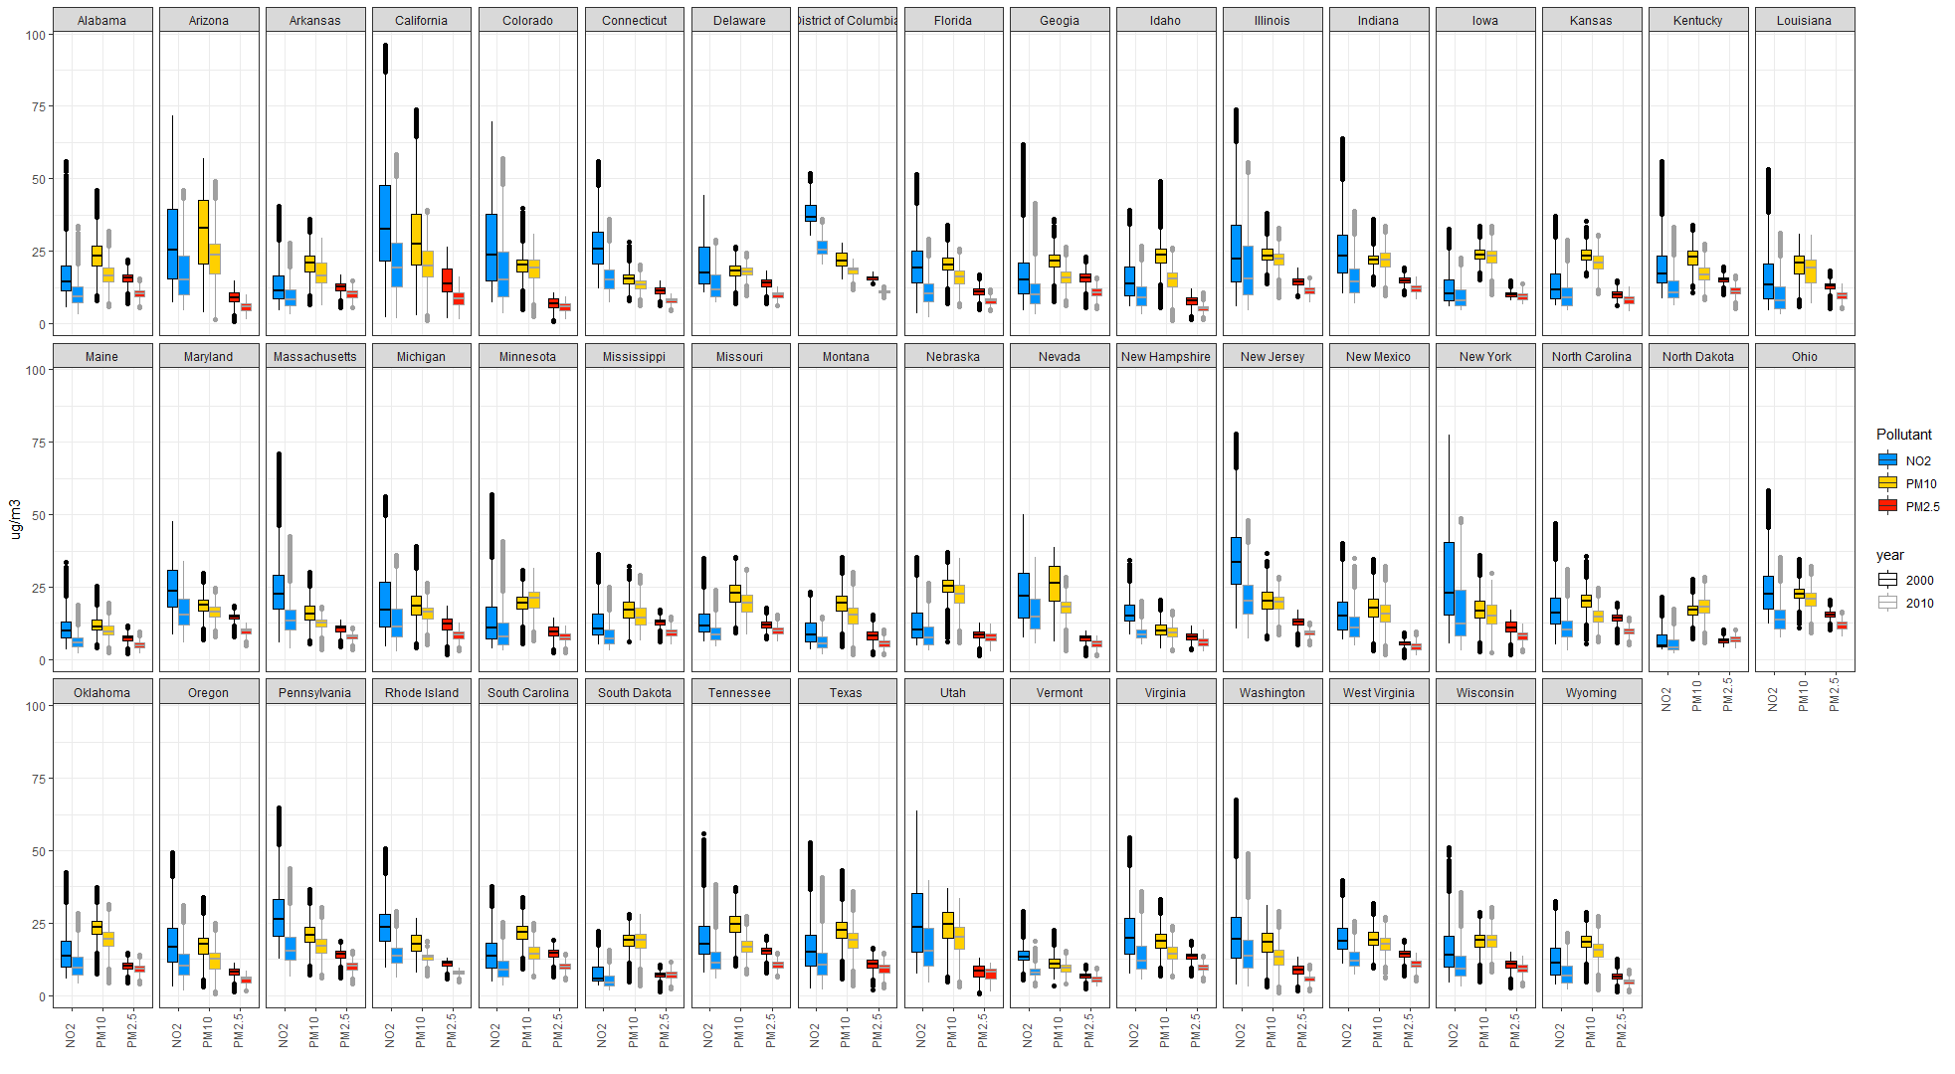
State Pollutant Concentrations
Notes:
Thoroughly explain how to read the boxplot (go through it slowly and ask if this is clear) {this is like the previous slide but for all state}
Go through an example for one state (this is like the national boxplot in previous slide)
Each boxplot is a state {point to the state name above some box plots. The states are in alphabetical order}
Within each plot there are three pollutants (blue for NO2, yellow for PM10, and red for PM2.5) {point to bars when explaining}
For each pollutant we have two years (left bar is year 2000 and right bar is year 2010) {point to bars when explaining}
The X axis is the pollutant
The Y axis is the concentration of the pollutant (each point represents a census block)
Quick show of values by state (you can point out to California, New Jersy, New York as vey high NO2 levels)

Slide 48
Methods – Sensitivity Analysis
All combinations of upper and lower (95% CI) of CRF & Asthma IR
Sensitivity analysis matrix

Slide 49
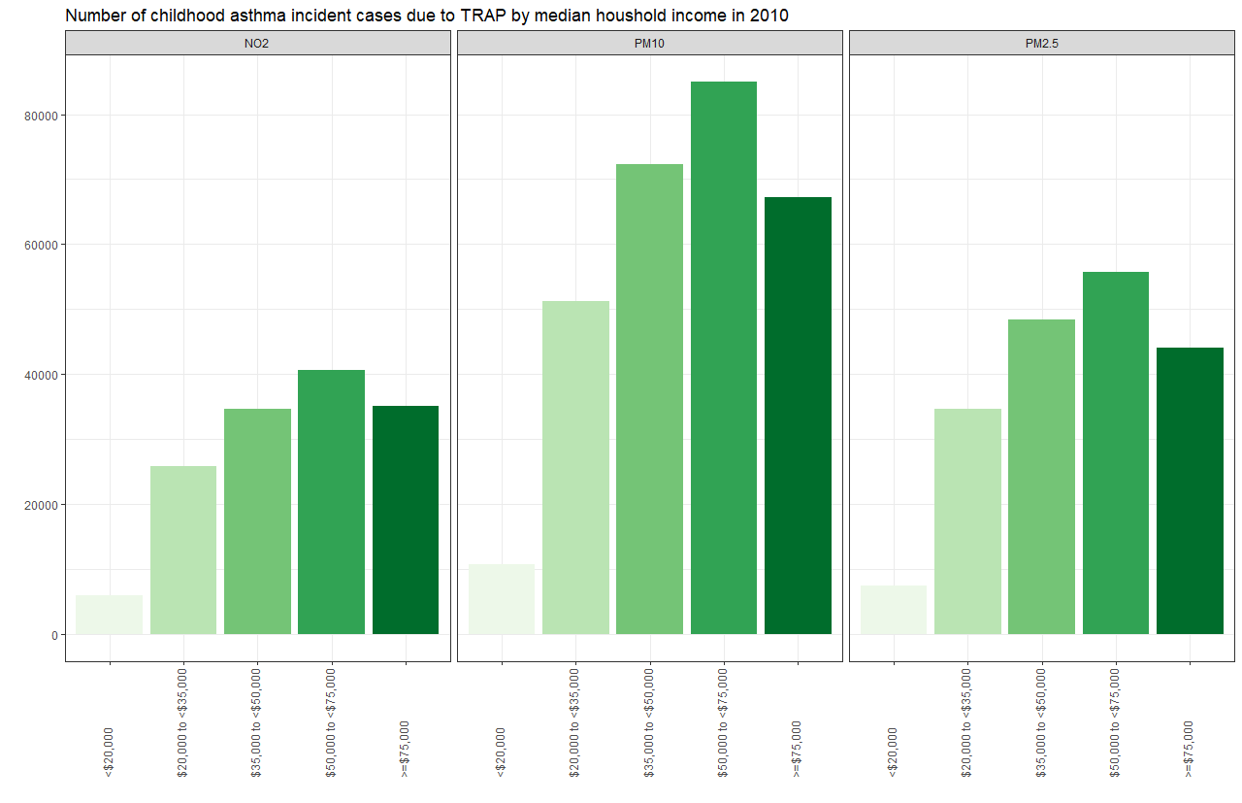
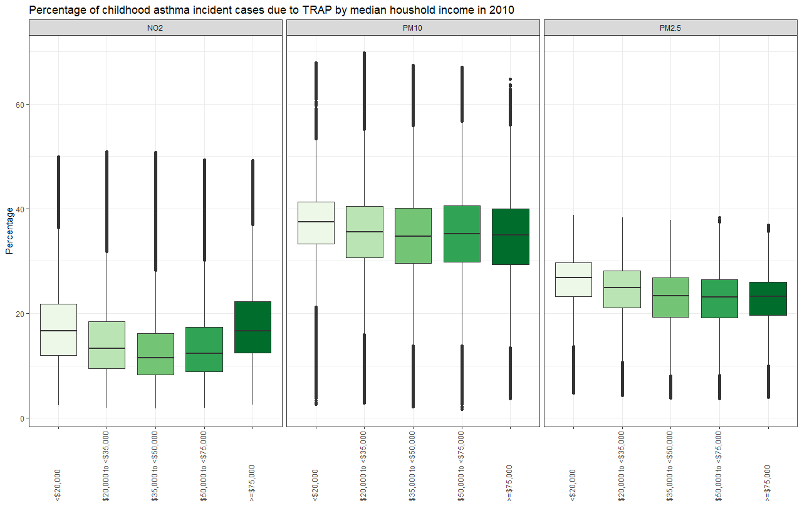
Median household income (2010)

Slide 50
Attributable number of cases and percentage of all cases
 |  | AC |  | % of all asthma cases |  | Change (%)
 |  | 2000 | 2010 | 2000 | 2010 | AC | AF
NO₂
Total |  | 209,100 | 141,900 | 27% | 18% | -32% | -33%
By Living Location | Urban | 184,500 | 127,500 | 30% | 20% | -31% | -33%
 | Rural | 24,600 | 14,500 | 15% | 10% | -41% | -33%
By Median Household Income | < 20,000 | 13,700 | 5,900 | 31% | 21% | N/A* | N/A*
 | 20,000 to <35,000 | 59,600 | 25,800 | 26% | 19%
 | 35,000 to <50,000 | 60,700 | 34,600 | 25% | 17%
 | 50,000 to <75,000 | 50,900 | 40,500 | 27% | 17%
 | >= 75,000 | 24,100 | 35,100 | 29% | 18%

Slide 51
Attributable number of cases and percentage of all cases
 |  | AC |  | % of all asthma cases |  | Change (%)
 |  | 2000 | 2010 | 2000 | 2010 | AC | AF
PM_{2.5}
Total |  | 247,100 | 190,200 | 31% | 24% | -23% | -24%
By Living Location | Urban | 200,100 | 158,200 | 32% | 24% | -21% | -24%
 | Rural | 47,100 | 32,000 | 28% | 22% | -32% | -23%
By Median Household Income | < 20,000 | 14,600 | 7,400 | 33% | 26% | N/A* | N/A*
 | 20,000 to <35,000 | 71,600 | 34,600 | 32% | 25%
 | 35,000 to <50,000 | 74,900 | 48,300 | 31% | 24%
 | 50,000 to <75,000 | 59,400 | 55,700 | 31% | 24%
 | >= 75,000 | 26,700 | 44,100 | 32% | 23%
PM₁₀
Total |  | 331,200 | 286,500 | 42% | 36% | -13% | -14%
By Living Location | Urban | 270,100 | 240,800 | 44% | 37% | -11% | -16%
 | Rural | 61,100 | 45,700 | 36% | 31% | -25% | -14%
By Median Household Income | < 20,000 | 19,800 | 10,700 | 45% | 38% | N/A* | N/A*
 | 20,000 to <35,000 | 98,300 | 51,300 | 43% | 37%
 | 35,000 to <50,000 | 100,800 | 72,300 | 42% | 36%
 | 50,000 to <75,000 | 78,700 | 85,000 | 41% | 36%
 | >= 75,000 | 33,700 | 67,300 | 40% | 35%

Slide 52
References
ANDERSON, H., FAVARATO, G. & ATKINSON, R. 2011. Long-term exposure to outdoor air pollution and the prevalence of asthma: meta-analysis of multi-community prevalence studies. Air Qual Atmos Health 2013; 6: 57–68. Nishimura KK, Galanter JM, Roth LA, et al. Early life air pollution and asthma risk in minority children: the GALA II & SAGE II studies. Am J Respir Crit Care Med, 188, 309-318.
ANDERSON, H. R., FAVARATO, G. & ATKINSON, R. W. 2013. Long-term exposure to air pollution and the incidence of asthma: meta-analysis of cohort studies. Air Quality, Atmosphere & Health, 6, 47-56.
BECHLE, M. J., MILLET, D. B. & MARSHALL, J. D. 2015. National spatiotemporal exposure surface for NO2: monthly scaling of a satellite-derived land-use regression, 2000–2010. Environmental science & technology, 49, 12297-12305.
BLACKWELL, D., VICKERIE, J. & WONDIMU, E. 2003. Summary health statistics for US children: National health interview survey, 2000. Vital Health Stat. National Center for Health Statistics.
BLOOM, B., COHEN, R. & FREEMAN, G. 2011. Summary health statistics for U.S. children: National Health Interview Survey, 2010. Vital Health Stat. National Center for Health Statistics.
CDC 2010. Asthma Severity among Children with Current Asthma.
CLARK, L. P., MILLET, D. B. & MARSHALL, J. D. 2017. Changes in transportation-related air pollution exposures by race-ethnicity and socioeconomic status: Outdoor nitrogen dioxide in the United States in 2000 and 2010. Environmental Health Perspectives, 125, 1--10.
EPA 2017. Managing Air Quality - Ambient Air Monitoring.
GLOBAL ASTHMA NETWORK 2014. The Global Asthma Report 2014.
GOWERS, A. M., CULLINAN, P., AYRES, J. G., ANDERSON, H. R., STRACHAN, D. P., HOLGATE, S. T., MILLS, I. C. & MAYNARD, R. L. 2012. Does outdoor air pollution induce new cases of asthma? Biological plausibility and evidence; a review. Respirology, 17, 887-898.
HEALTH EFFECTS INSTITUTE, H. E. I. 2010. Traffic-related air pollution: a critical review of the literature on emissions, exposure, and health effects, Special Report 17. HEI Panel on the Health Effects of Traffic-Related Air Pollution. Health Effects Institute, Boston, Massachusetts, 2010.
KHREIS, H., DE HOOGH, K. & NIEUWENHUIJSEN, M. J. 2018a. Full-chain health impact assessment of traffic-related air pollution and childhood asthma. Environment international, 114, 365-375.
KHREIS, H., KELLY, C., TATE, J., PARSLOW, R., LUCAS, K. & NIEUWENHUIJSEN, M. 2017. Exposure to traffic-related air pollution and risk of development of childhood asthma: a systematic review and meta-analysis. Environment international, 100, 1-31.

Slide 53
References
KHREIS, H., RAMANI, T., DE HOOGH, K., MUELLER, N., ROJAS-RUEDA, D., ZIETSMAN, J. & NIEUWENHUIJSEN, M. J. 2018b. Traffic-Related Air Pollution and the Local Burden of Childhood Asthma in Bradford, UK. International Journal of Transportation Science and Technology.
KRZYZANOWSKI, M. & COHEN, A. 2008. Update of WHO air quality guidelines. Air Quality, Atmosphere & Health, 1, 7-13.
MANSON, S., SCHROEDER, J., VAN RIPER, D. & RUGGLES, S. 2017. IPUMS National Historical Geographic Information System: Version 12.0 [Database]. Minneapolis: University of Minnesota. 2017.
NURMAGAMBETOV, T., KUWAHARA, R. & GARBE, P. 2018. The economic burden of asthma in the United States, 2008–2013. Annals of the American Thoracic Society, 15, 348-356.
PEREZ, L., DECLERCQ, C., IÑIGUEZ, C., AGUILERA, I., BADALONI, C., BALLESTER, F., BOULAND, C., CHANEL, O., CIRARDA, F. B. & FORASTIERE, F. 2013. Chronic burden of near-roadway traffic pollution in 10 European cities (APHEKOM network). European Respiratory Journal, erj00311-2012.
PEREZ, L., KÜNZLI, N., AVOL, E., HRICKO, A. M., LURMANN, F., NICHOLAS, E., GILLILAND, F., PETERS, J. & MCCONNELL, R. 2009. Global goods movement and the local burden of childhood asthma in southern California. American Journal of Public Health, 99, S622-S628.
R CORE TEAM 2018. R: A Language and Environment for Statistical Computing. R Foundation for Statistical Computing.
ROWANGOULD, G. M. 2013. A census of the US near-roadway population: Public health and environmental justice considerations. Transportation Research Part D: Transport and Environment, 25, 59-67.
THE LANCET 2018. Asthma in US children. The Lancet, 391, 632.
US CENSUS BUREAU 2010. American factfinder. US Census Bureau Washington, DC.
WENZEL, S. E. 2012. Asthma phenotypes: the evolution from clinical to molecular approaches. Nature medicine, 18, 716.
WHO 2005. Air Quality Guidlines Global Update 2005.
WINER, R. A., QIN, X., HARRINGTON, T., MOORMAN, J. & ZAHRAN, H. 2012. Asthma incidence among children and adults: findings from the Behavioral Risk Factor Surveillance system asthma call-back survey—United States, 2006–2008. Journal of Asthma, 49, 16-22

Slide 54
Outline (Slide is hidden)
Introduction
Childhood asthma (definition, statistics, costs associated, and causes)
New emerging evidence of TRAP
Rational for the study (Meta-analysis, development of LUR model)
What this study tries to achieve (estimate US burden across two years)
Methods and {some results}
Study area and time points
Census data
Asthma incidence and prevalence {results}
Concentration response function {results}
LUR Models
Formulas
“Safety level” scenarios
Sensitivity analysis
Software used
Results
Pollutants concentration results by state
Attributable number of asthma incident cases
Attributable number of asthma incident cases by living location
Attributable number of asthma incident cases by median household income
“Safe levels” scenarios
Sensitivity analysis
Interactive Maps
Discussion
Summary of key findings
Comparing with previous studies
Strengths and limitations
Conclusion
References

